Slide 1
Introduction to Accounting

Slide 2
What is Accounting?
Accounting is an Information System. The purpose of accounting is to: identify, record, classify and summarize and finally communicate the economic events of an organization to interested users.

Slide 3
Who Uses Accounting Data?
Internal Users
Management
TAX
Human Resources
Investors
There are two broad groups of users of financial information: internal users and external users.
Labor Unions
Finance
Creditors
Marketing
SEC
Customers
External Users

Slide 4
Who Uses Accounting Data?
Common Questions Asked
User
1. Can we afford to give our employees a pay raise?
Human Resources
2. Did the company earn a satisfactory income?
Investors
3. Do we need to borrow in the near future?
Management
4. Is cash sufficient to pay dividends to the stockholders?
Finance
5. What price for our product will maximize net income?
Marketing
6. Will the company be able to pay its short-term debts?
Creditors

Slide 5
Who Uses Accounting Data?
Discussion Question
Q1. “Accounting is ingrained in our society and it is vital to our economic system.” Do you agree? Explain.
Notes:
Question 1 (textbook) Yes, this is correct. Virtually every organization and person in our society uses accounting information. Businesses, investors, creditors, government agencies, and not-for-profit organizations must use accounting information to operate effectively.

Slide 6

The Building Blocks of Accounting
Ethics In Financial Reporting
Standards of conduct by which one’s actions are judged as right or wrong, honest or dishonest, fair or not fair, are Ethics.
  Effective financial reporting depends on sound ethical behavior.

Slide 7

The Building Blocks of Accounting
Financial Statements
Balance Sheet
Income Statement
Statement of Owner’s Equity
Statement of Cash Flows
Note Disclosure
Various users need financial information
The accounting profession has attempted to develop a set of standards that are generally accepted and universally practiced.
Generally Accepted Accounting Principles (GAAP)

Slide 8



The Building Blocks of Accounting
Organizations Involved in Standard Setting:
  Securities and Exchange Commission (SEC)
  Financial Accounting Standards Board (FASB)
  International Accounting Standards Board (IASB)
http://www.sec.gov/
http://www.fasb.org/
http://www.iasb.org/

Slide 9

Forms of Business Ownership
Proprietorship
Partnership
Corporation
Generally owned by one person.
Often small service-type businesses
Owner receives any profits, suffers any losses, and is personally liable for all debts.
Owned by two or more persons.
Often retail and service-type businesses
Generally unlimited personal liability
Partnership agreement
Ownership divided into shares of stock
Separate legal entity organized under state corporation law
Limited liability
Notes:
Service Cost - Actuaries compute service cost as the present value of the new benefits earned by employees during the year. Future salary levels considered in calculation.
Interest on Liability - Interest accrues each year on the PBO just as it does on any discounted debt.
Actual Return on Plan Assets - Increase in pension funds from interest, dividends, and realized and unrealized changes in the fair market value of the plan assets.
Amortization of Unrecognized Prior Service Cost - The cost of providing retroactive benefits is allocated to pension expense in the future, specifically to the remaining service-years of the affected employees.
Gain or Loss - Volatility in pension expense can be caused by sudden and large changes in the market value of plan assets and by changes in the projected benefit obligation. Two items comprise the gain or loss:
difference between the actual return and the expected return on plan assets and,
amortization of the unrecognized net gain or loss from previous periods

Slide 10
The Basic Accounting Equation
Assets
Liabilities
Owner’s Equity
=
+
Provides the underlying framework for recording and summarizing economic events.
Assets are claimed by either creditors or owners.
Claims of creditors must be paid before ownership claims.

Slide 11
The Basic Accounting Equation
Assets
Liabilities
Owner’s Equity
=
+
Provides the underlying framework for recording and summarizing economic events.
Assets
  Resources a business owns.
  Provide future services or benefits.
  Cash, Supplies, Equipment, etc.

Slide 12
The Basic Accounting Equation
Assets
Liabilities
Owner’s Equity
=
+
Provides the underlying framework for recording and summarizing economic events.
Liabilities
  Claims against assets (debts and obligations).
  Creditors - party to whom money is owed.
  Accounts payable, Notes payable, etc.

Slide 13
The Basic Accounting Equation
Assets
Liabilities
Owner’s Equity
=
+
Provides the underlying framework for recording and summarizing economic events.
Owner’s Equity
  Ownership claim on total assets.
  Referred to as residual equity.
  Capital, Drawings, etc. (Proprietorship or Partnership).

Slide 14
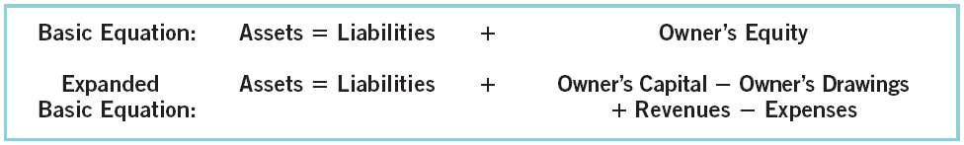
Owner’s Equity
Revenues result from business activities entered into for the purpose of earning income.
Common sources of revenue are: sales, fees, services, commissions, interest, dividends, royalties, and rent.

Slide 15
Owner’s Equity
Expenses are the cost of assets consumed or services used in the process of earning revenue.
Common expenses are: salaries expense, rent expense, utilities expense, tax expense, etc.

Slide 16
Using The Basic Accounting Equation
Transactions are a business’s economic events recorded by accountants.
  May be external or internal.
  Not all activities represent transactions.
  Each transaction has a dual effect on the accounting equation.

Slide 17


Transactions (Question?)
Q1-15: Are the following events recorded in the accounting records?
Owner withdraws cash for personal use.
Supplies are purchased on account.
An employee is hired.
Event
Criterion
Is the financial position (assets, liabilities, or owner’s equity) of the company changed?
Record/ Don’t Record

Slide 18
Transactions
Discussion Question
Q1-18. In February 2010, Paula King invested an additional $10,000 in her business, King’s Pharmacy, which is organized as a proprietorship. King’s accountant, Lance Jones, recorded this receipt as an increase in cash and revenues. Is this treatment appropriate? Why or why not?
Notes:
Question 18 (Chapter 1) No, this treatment is not proper. While the transactions does involve a receipt of cash, it does not represent revenues. Revenues are the gross increase in owner’s equity resulting from business activities entered into for the purpose of earning income. This transactions is simply an additional investment made by the owner in the business.

Slide 19
Transactions (Problem)
P1-1A: Barone’s Repair Shop was started on May 1 by Nancy Barone. Prepare a tabular analysis of the following transactions for the month of May.
1. Invested $10,000 cash to start the repair shop.
=
Liabilities
Assets
+
Owners’ Equity
Accounts Receivable
Accounts Payable
Barone, Capital
Barone, Drawing
Cash
+
+
Equipment
=
+
-
+
Revenues
-
Expenses
1.
+10,000
+10,000

Slide 20
Transactions (Problem)
2. Purchased equipment for $5,000 cash.
=
Liabilities
Assets
+
Owners’ Equity
Accounts Receivable
Accounts Payable
Barone, Capital
Barone, Drawing
Cash
+
+
Equipment
=
+
-
+
Revenues
-
Expenses
1.
+10,000
+10,000
2.
-5,000
+5,000
3.
4.
5.
6.
7.
8.
9.
10.

Slide 21
Transactions (Problem)
3. Paid $400 cash for May office rent.
=
Liabilities
Assets
+
Owners’ Equity
Accounts Receivable
Accounts Payable
Barone, Capital
Barone, Drawing
Cash
+
+
Equipment
=
+
-
+
Revenues
-
Expenses
1.
+10,000
+10,000
2.
-5,000
+5,000
3.
-400
-400
4.
5.
6.
7.
8.
9.
10.

Slide 22
Transactions (Problem)
4. Incurred $250 of advertising costs, on account.
=
Liabilities
Assets
+
Owners’ Equity
Accounts Receivable
Accounts Payable
Barone, Capital
Barone, Drawing
Cash
+
+
Equipment
=
+
-
+
Revenues
-
Expenses
1.
+10,000
+10,000
2.
-5,000
+5,000
3.
-400
-400
4.
+250
-250
5.
6.
7.
8.
9.
10.

Slide 23
Transactions (Problem)
5. Received $5,100 from customers for repair service.
=
Liabilities
Assets
+
Owners’ Equity
Accounts Receivable
Accounts Payable
Barone, Capital
Barone, Drawing
Cash
+
+
Equipment
=
+
-
+
Revenues
-
Expenses
1.
+10,000
+10,000
2.
-5,000
+5,000
3.
-400
-400
4.
+250
-250
5.
+5,100
+5,100
6.
7.
8.
9.
10.

Slide 24
Transactions (Problem)
6. Withdrew $1,000 cash for personal use.
=
Liabilities
Assets
+
Owners’ Equity
Accounts Receivable
Accounts Payable
Barone, Capital
Barone, Drawing
Cash
+
+
Equipment
=
+
-
+
Revenues
-
Expenses
1.
+10,000
+10,000
2.
-5,000
+5,000
3.
-400
-400
4.
+250
-250
5.
+5,100
+5,100
6.
-1,000
-1,000
7.
8.
9.
10.

Slide 25
Transactions (Problem)
7. Paid part-time employee salaries of $2,000.
=
Liabilities
Assets
+
Owners’ Equity
Accounts Receivable
Accounts Payable
Barone, Capital
Barone, Drawing
Cash
+
+
Equipment
=
+
-
+
Revenues
-
Expenses
1.
+10,000
+10,000
2.
-5,000
+5,000
3.
-400
-400
4.
+250
-250
5.
+5,100
+5,100
6.
-1,000
-1,000
7.
-2,000
-2,000
8.
9.
10.

Slide 26
Transactions (Problem)
8. Paid utility bills $140.
=
Liabilities
Assets
+
Owners’ Equity
Accounts Receivable
Accounts Payable
Barone, Capital
Barone, Drawing
Cash
+
+
Equipment
=
+
-
+
Revenues
-
Expenses
1.
+10,000
+10,000
2.
-5,000
+5,000
3.
-400
-400
4.
+250
-250
5.
+5,100
+5,100
6.
-1,000
-1,000
7.
-2,000
-2,000
8.
-140
-140
9.
10.

Slide 27
Transactions (Problem)
9. Provided $750 of repair services on account.
=
Liabilities
Assets
+
Owners’ Equity
Accounts Receivable
Accounts Payable
Barone, Capital
Barone, Drawing
Cash
+
+
Equipment
=
+
-
+
Revenues
-
Expenses
1.
+10,000
+10,000
2.
-5,000
+5,000
3.
-400
-400
4.
+250
-250
5.
+5,100
+5,100
6.
-1,000
-1,000
7.
-2,000
-2,000
8.
-140
-140
9.
+750
+750
10.

Slide 28
Transactions (Problem)
10. Collected $120 cash for services previously billed.
=
Liabilities
Assets
+
Owners’ Equity
Accounts Receivable
Accounts Payable
Barone, Capital
Barone, Drawing
Cash
+
+
Equipment
=
+
-
+
Revenues
-
Expenses
1.
+10,000
+10,000
2.
-5,000
+5,000
3.
-400
-400
4.
+250
-250
5.
+5,100
+5,100
6.
-1,000
-1,000
7.
-2,000
-2,000
8.
-140
-140
9.
+750
+750
10.
+120
-120

Slide 29
Transactions (Problem)
10. Collected $120 cash for services previously billed.
=
Liabilities
Assets
+
Owners’ Equity
Accounts Receivable
Accounts Payable
Barone, Capital
Barone, Drawing
Cash
+
+
Equipment
=
+
-
+
Revenues
-
Expenses
1.
+10,000
+10,000
2.
-5,000
+5,000
3.
-400
-400
4.
+250
-250
5.
+5,100
+5,100
6.
-1,000
-1,000
7.
-2,000
-2,000
8.
-140
-140
9.
+750
+750
10.
+120
-120
+6,680
+630
+5,000
=
-1,000
+250
+10,000
+5,850
-2,790
$12,310
$12,310

Slide 30
Financial Statements
Companies prepare four financial statements from the summarized accounting data:
Income Statement
Owner’s Equity Statement
Balance Sheet
Statement of Cash Flows

Slide 31
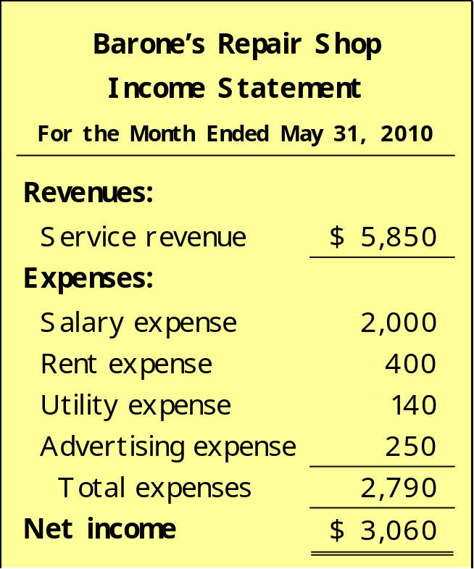
Financial Statements
Income Statement
Reports the revenues and expenses for a specific period of time.
Net income – revenues exceed expenses.
Net loss – expenses exceed revenues.

Slide 32
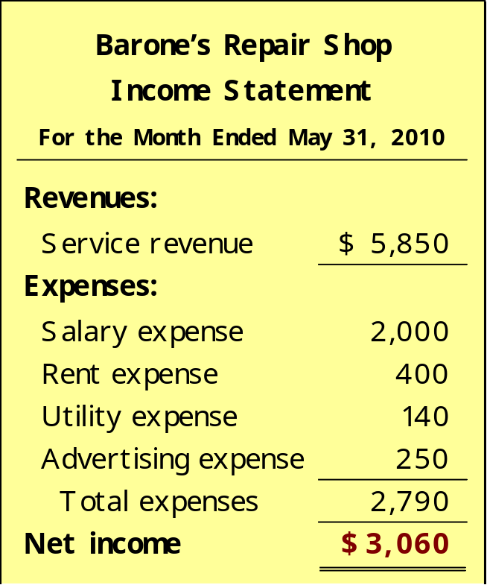
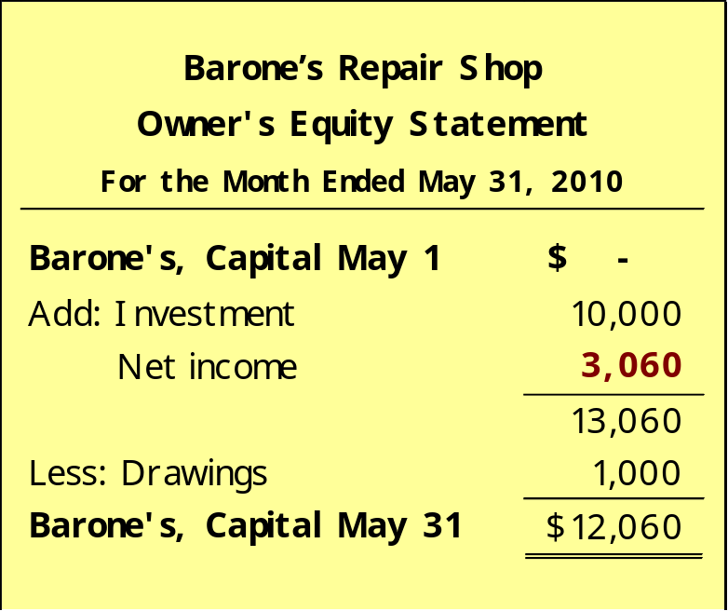
Financial Statements
Income Statement
Owner’s Equity Statement
Net income is needed to determine the ending balance in owner’s equity.

Slide 33

Financial Statements
Owner’s Equity Statement
Statement indicates the reasons why owner’s equity has increased or decreased during the period.

Slide 34
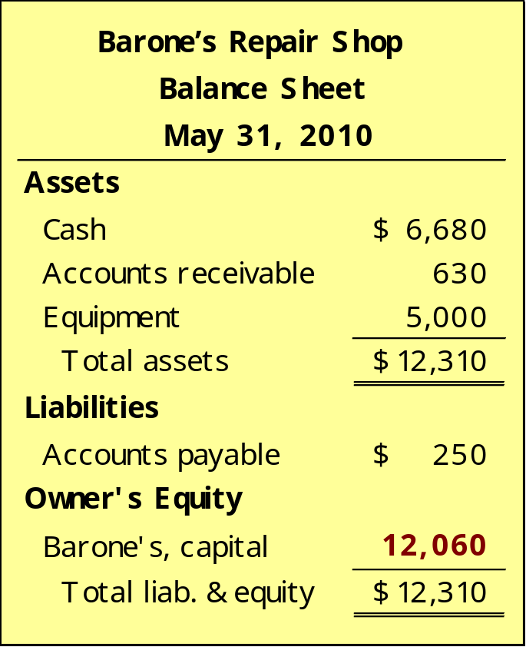
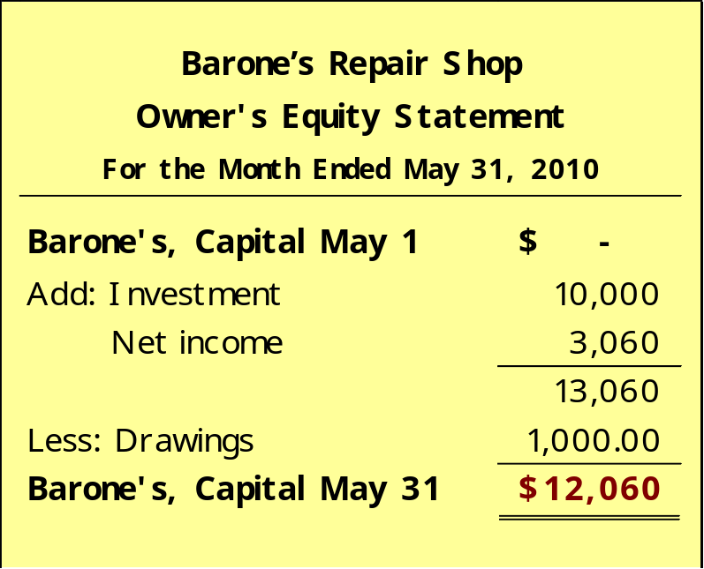
Financial Statements
Balance Sheet
Owner’s Equity Statement
The ending balance in owner’s equity is needed in preparing the balance sheet

Slide 35
Financial Statements
Balance Sheet
Reports the assets, liabilities, and owner’s equity at a specific date.
Assets listed at the top, followed by liabilities and owner’s equity.
Total assets must equal total liabilities and owner’s equity.

Slide 36
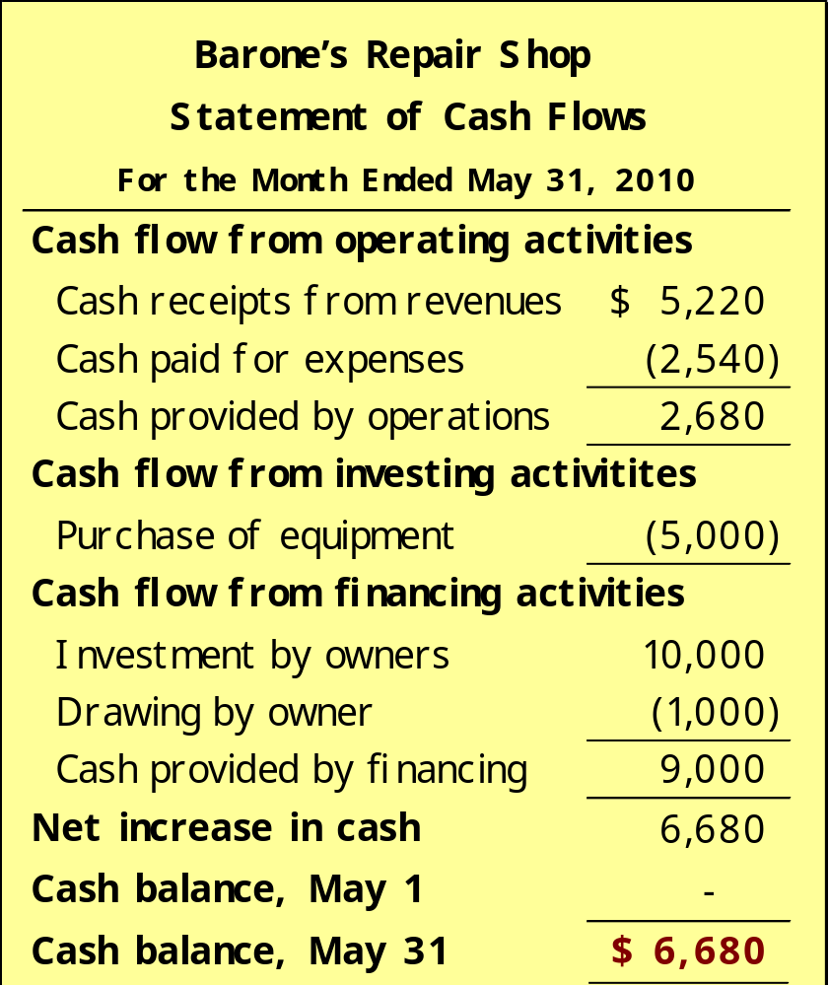
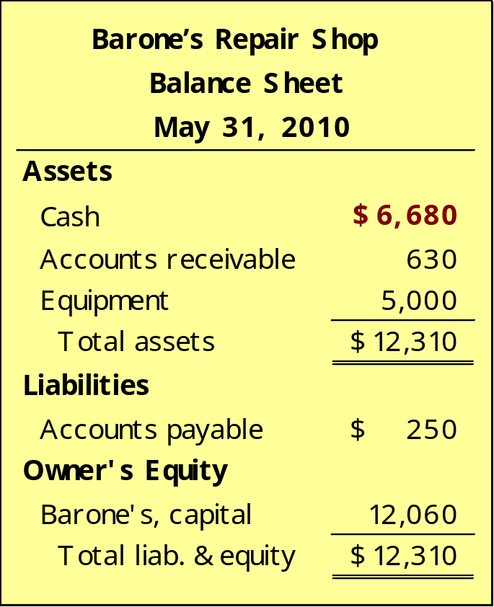
Financial Statements
Statement of Cash Flows
Balance Sheet

Slide 37
Financial Statements
Statement of Cash Flows
Information for a specific period of time.
Answers the following:
Where did cash come from?
What was cash used for?
What was the change in the cash balance?

Slide 38
Financial Statements
Review Question
Which of the following financial statements is prepared as of a specific date?
  Balance sheet.
  Income statement.
  Owner's equity statement.
  Statement of cash flows.

Slide 39
Financial Statements
Discussion Question
Q1-19. “A company’s net income appears directly on the income statement and the owner’s equity statement, and it is included indirectly in the company’s balance sheet.” Do you agree? Explain.
Notes:
Question 19 (textbook) Y e s . Net income does appear on the income statement — it is the result of subtracting expenses from revenues. In addition, net income appears in the statement of owner’s equity—it is shown as an addition to the beginning-of-period capital. Indirectly, the net income of a company is also included in the balance sheet. It is included in the capital account which appears in the owner’s equity section of the balance sheet.

